Slide 1
Understanding Eternalblue
ENPM696 Reverse Software Engineering
Vinaykumar Yennam
Jorge Damian
Dheepshika Raghunathan

Slide 2
Let’s Begin!
We are...
Eternal blue is an exploitation tool
Execute remote shellcode
Created by NSA
Made public by Shadow Brokers
Exploits vulnerabilities in SMB protocol
Used in WannaCry

Slide 3
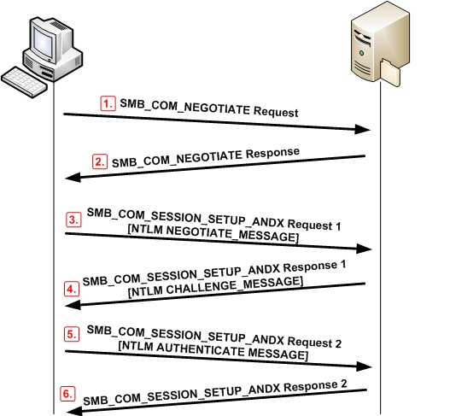
SMB protocol cont’d
Server Message Block protocol
Originally open-source and Linux based
Modified to operate on Windows
Used for
Shared access to files, printers, and serial ports
Miscellaneous communications between nodes on a network
Mechanism for authenticated inter-process communication

Slide 4
Bugs in smb protocol
Bug A - Wrong Casting Bug
Occurs when converting File Extended Attributes(FEA) from Os2 structure to NT structure
Bug B - Wrong Parsing Function Bug
Occurs when the wrong parsing function is called when transferring large parameter and data blocks
Bug C - Non-paged Pool Allocation Bug
Allocates large chunk of memory in the kernel non-paged pool, where shellcode could be placed

Slide 5
Bug a Wrong Casting Bug

Slide 6
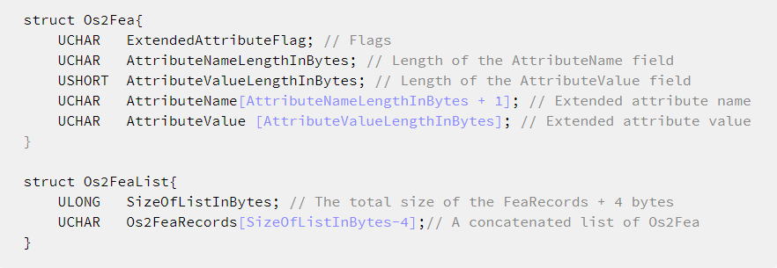
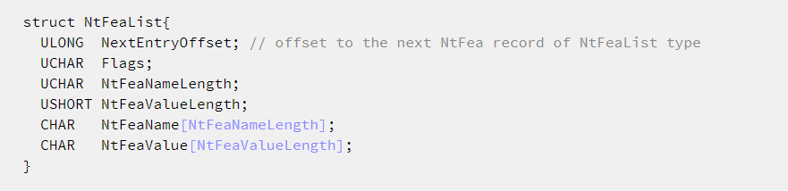
FEA formats
OS2
NT

Slide 7
Interesting functions
Available in the srv.sys driver
SrvOs2FeaListToNt
Converts Os2 FEA List to NT FEA List
SrvOs2FeaListSizeToNT
Calculates the size needed to convert Os2FeaList structures into the appropriate NtFeaList structures
SrvOs2FeaToNT
Converts Os2 record to NT record

Slide 8
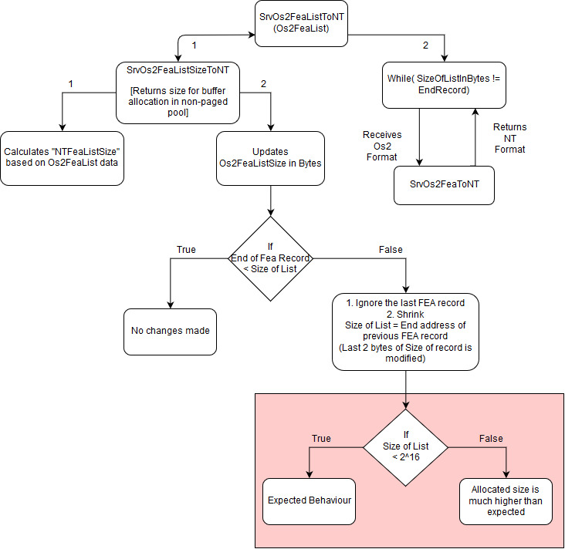
Control flow logic
Buggy Code

Slide 9
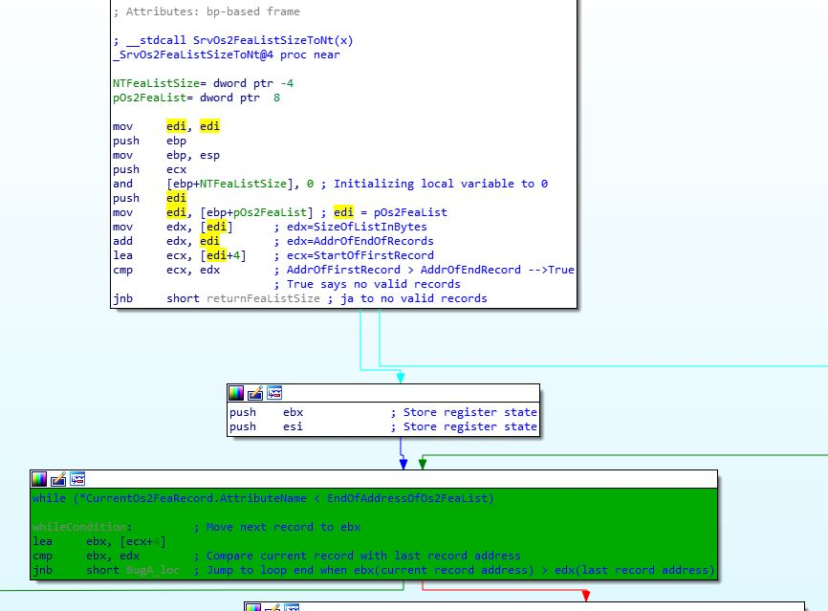
The buggy function

Slide 10
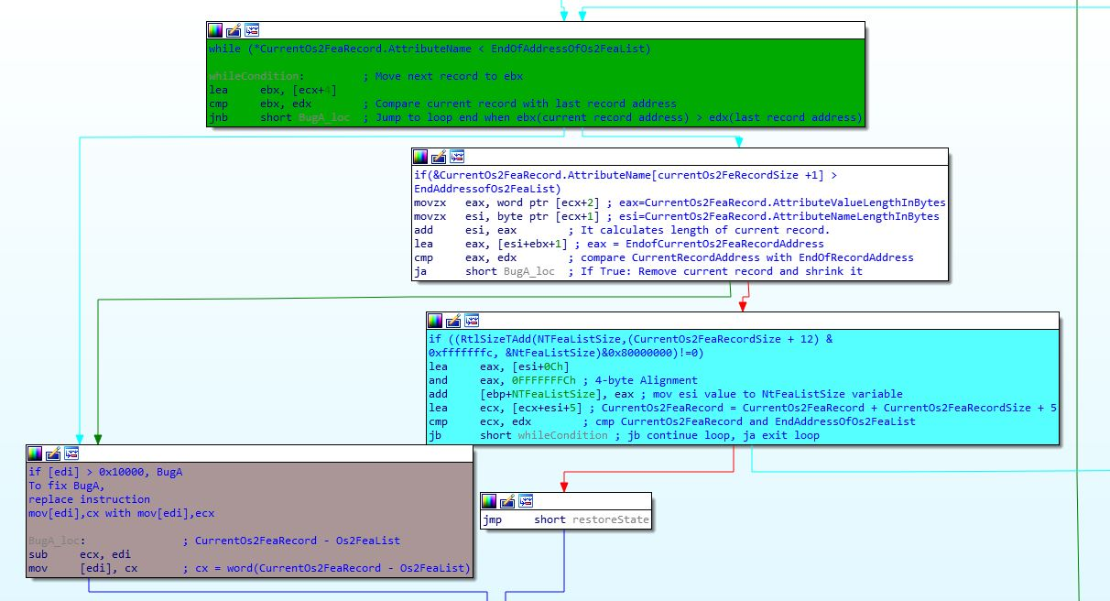
The buggy function con’t

Slide 11
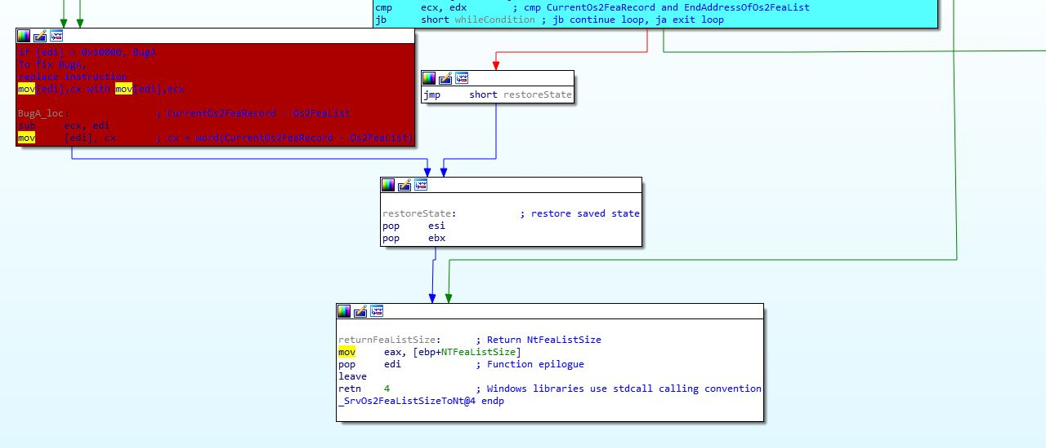
The buggy function con’t

Slide 12
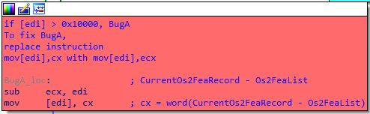
The buggy code

Slide 13
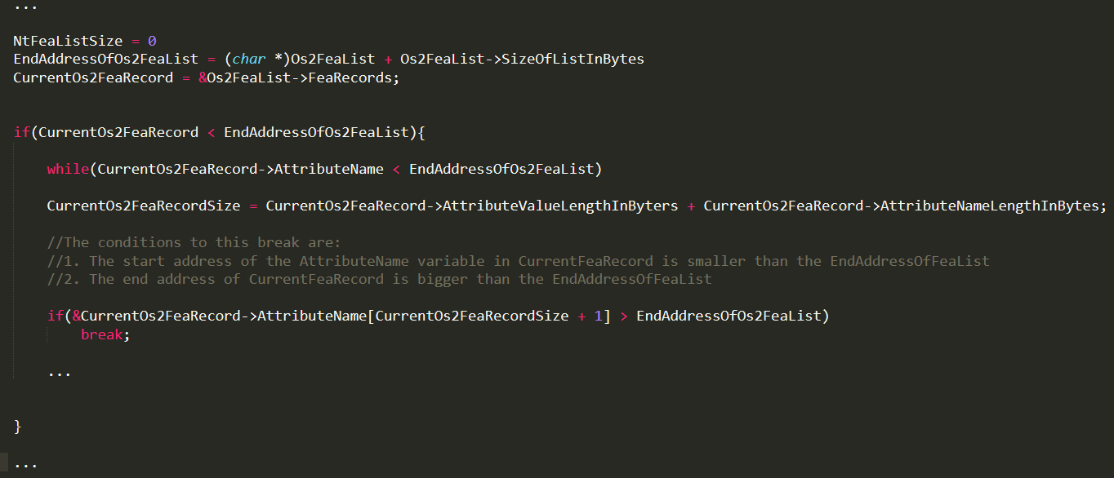
Pseudocode

Slide 14
Bug B Wrong Parsing function Bug

Slide 15
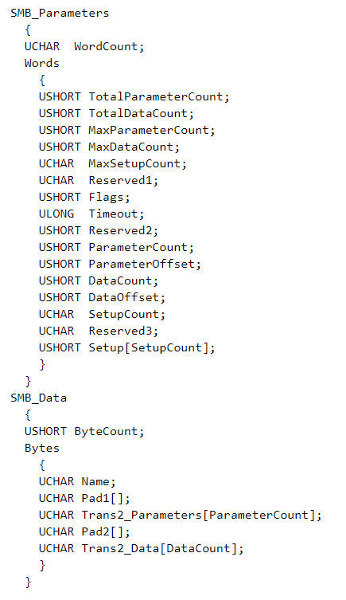
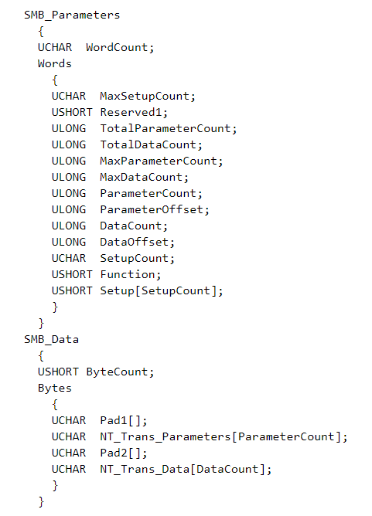
DATA RELATED FUNCTIONS
SMB_COM_TRANSACTION2
SMB_COM_NT_TRANSACT

Slide 16
EXPLAINING THE FUNCTIONS
SMB_COM_TRANSACTION2
Provide support for a richer server-side file system semantics.
Trans2 subcommands: allow clients to set and retrieve Extended Attribute key/value pairs, make use of long file names, perform directory searches, etc.
SMB_COM_NT_TRANSACT
Extend the file system feature access offered by SMB_COM_TRANSACTION2.
Allow for the transfer of very large parameter and data blocks.

Slide 17
The wrong parsing bug
If the data sent via SMB_COM_TRANSACTION2 or by SMB_COM_NT_TRANSACT exceeds the MaxBufferSize established during session setup, or total data to send is bigger than transmitted_data, then the transaction uses the SECONDARY sub-command.
Each sub-command has a corresponding sub-command _SECONDARY.
The packets that follow the first sub-command have the corresponding _SECONDARY sub-command set as their command.
Ex.: SMB_COM_NT_TRANSACT => SMB_COM_NT_TRANSACT_SECONDARY

Slide 18
The wrong parsing bug, CONT.
In SMB_COM_TRANSACTION2, the maximum data that can be sent is represented by a parameter in the header of SMB_COM_TRANSACTION2 in the field of a Word size (0xFFFF).
However, in SMB_COM_NT_TRANSACT, the maximum data that can be sent is represented by a parameter in the header of SMB_COM_NT_TRANSACT in the field of Dword size (0XFFFFFFFF).
However, there is no validation for which function started the transaction. Thus, it’s possible to send SMB_COM_NT_TRANSACT followed by SMB_COM_TRANSACTION2_SECONDARY. This situation can lead to wrong data parsing, and this bug enables Bug A by treating Dword as Word.

Slide 19
Bug C Non-paged pool allocation bug

Slide 20
CONFIGURING THE SMB SESSION
An SMB_COM_SESSION_SETUP_ANDX request MUST be sent by a client to begin user authentication on an SMB connection and establish an SMB session.
At least one SMB_COM_SESSION_SETUP_ANDX MUST be sent to perform a user logon to the server and to establish a valid UID.
There are two formats for an SMB_COM_SESSION_SETUP_ANDX request: LM and NTLM authentication, and NTLMv2 (NTLM SSP).

Slide 21
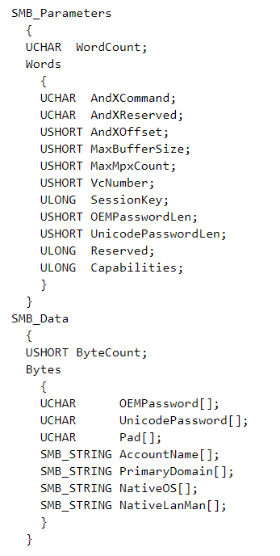
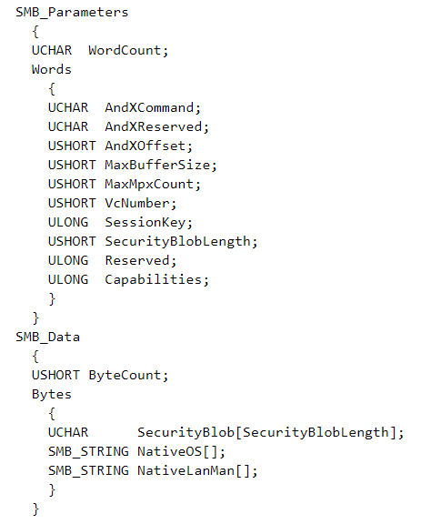
SMB_COM_SESSION_SETUP_ANDX
LM and NTLM
NTLMv2 (NTLM SSP)

Slide 22
SMB_COM_SESSION_SETUP_ANDX, CONT.
In both formats, the request is split into 2 sections:
SMB_Parameters – Contains parameters of sizes between 1-4 bytes. The WordCount field represents the total length of SMB_Parameters struct members in a Word size.
SMB_Data – Contains data in a variable size. The ByteCount field represents the length of the SMB_Data struct members section in bytes.
Summing the size of the fields, in the first format, the WordCount equals 13 and in the second format (extended security), the WordCount equals 12.
The SMB_COM_SESSION_SETUP_ANDX request is handled by the BlockingSessionSetupAndX function. This function wrongly calculates ByteCount, which leads to an allocation of controlled size – bigger than the packet data – in the non-paged pool.

Slide 23
UNDERSTANDING THE BUG
Sending an SMB_COM_SESSION_SETUP_ANDX request as Extended Security (WordCount 12) with CAP_EXTENDED_SECURITY, but without FLAGS2_EXTENDED_SECURITY, the request will be processed wrongly as an NT Security request (WordCount 13) by the GetNtSecurityParameters function.

Slide 24
Understanding THE BUG, CONT.
As a result, the function reads ByteCount from the wrong offset in the struct, and allocates space in the non-paged kernel pool for NativeOs and NativeLanMan unicode strings.
This bug allows you to send a small packet that leads to a big allocation in the non-paged pool, which is used to create a big allocation as a placeholder.
This allocation will later be freed (creating a HOLE) and allocated again by an NtFea chunk that will overflow the next chunk.

Slide 25
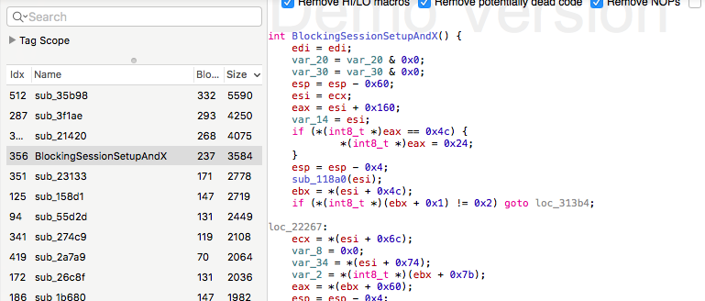
The buggy code

Slide 26
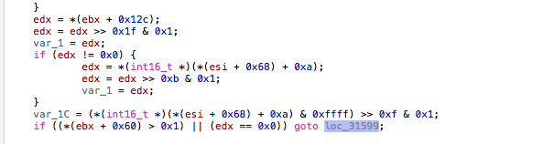
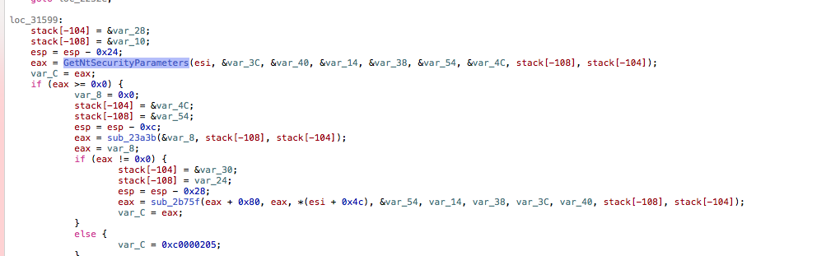
The buggy code con’t

Slide 27
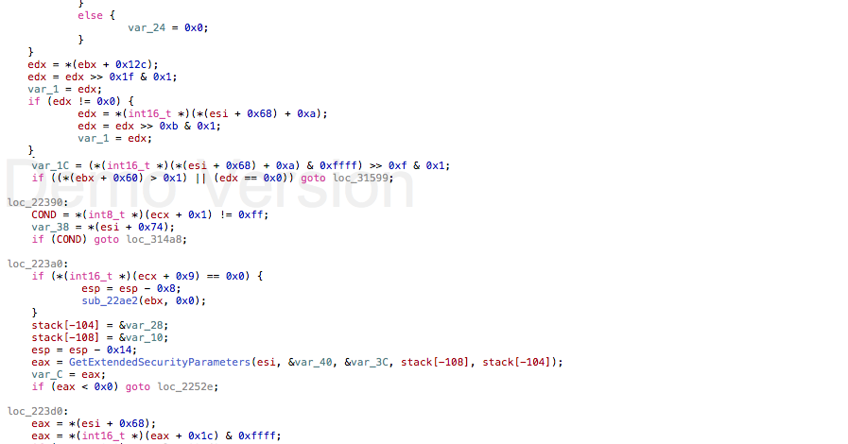
The buggy code con’t

Slide 28
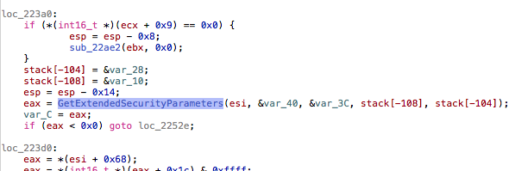
The buggy code con’t

Slide 29
Summary

Slide 30
Thank You!

